Slide 1

Overseas Stock Markets - Chartbook
Cliff Jarvis | Vice President - Investments | April 5, 2021

Slide 2
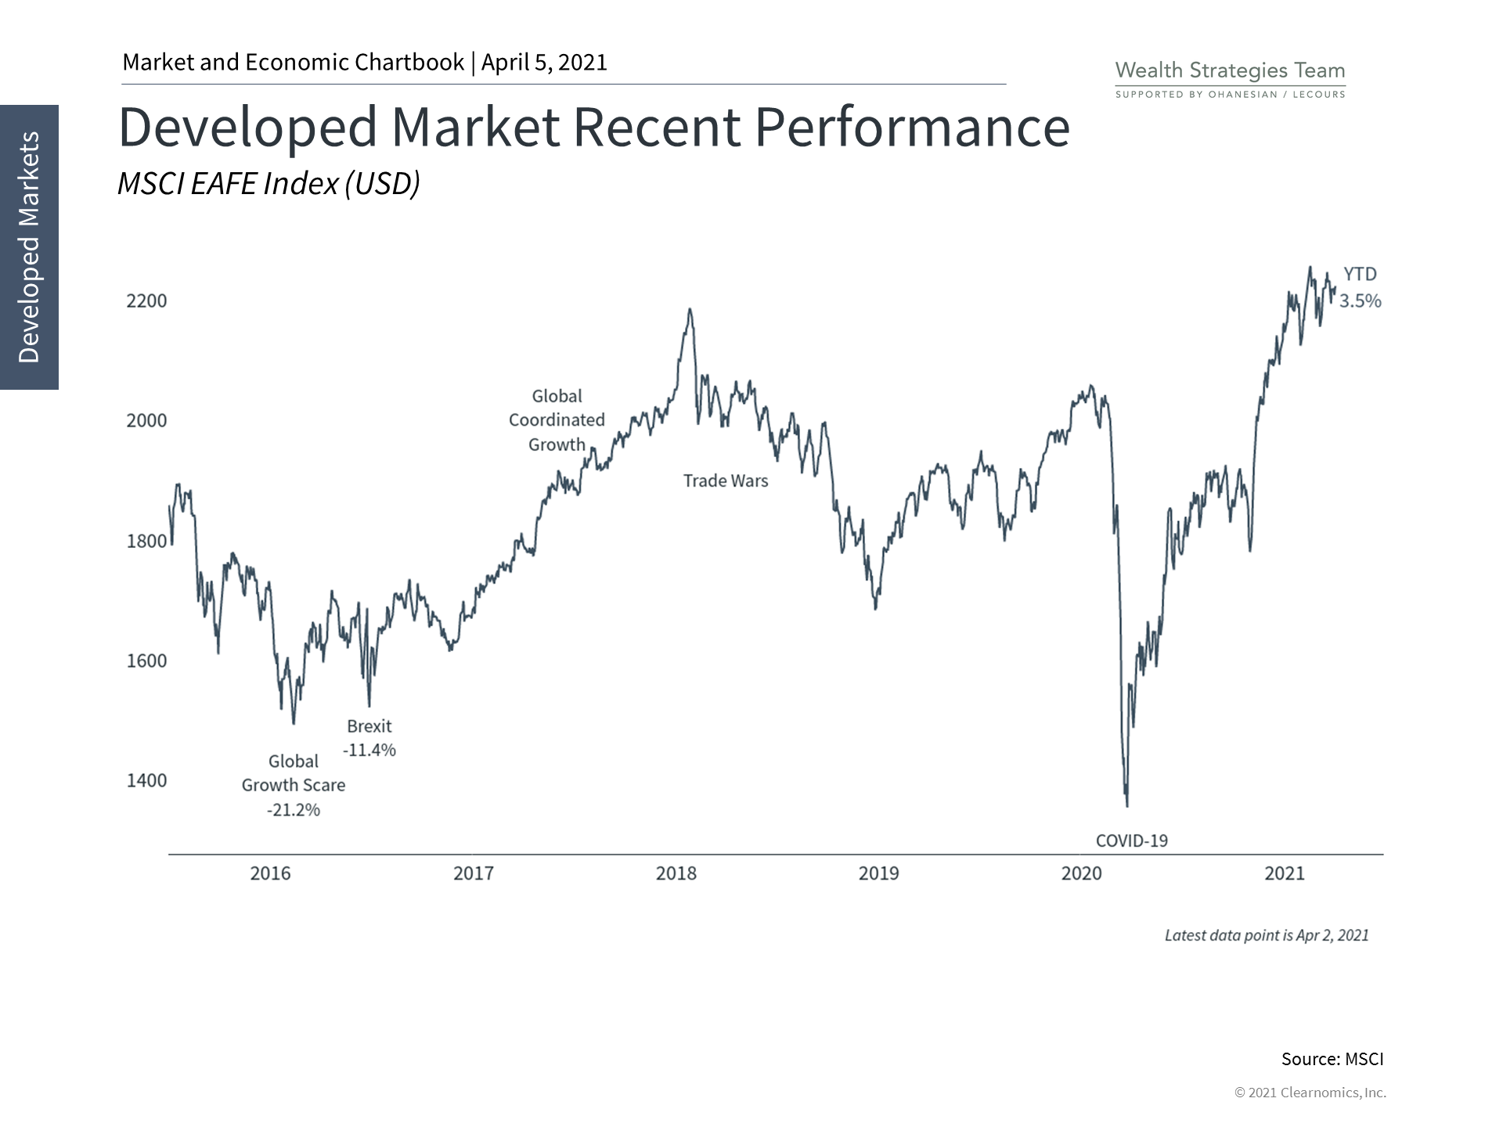
The Developed markets have recovered alongside many other regions since the pandemic-induced market crash.
Many countries, especially those in Europe, continue to face high COVID-19 case rates.

Slide 3
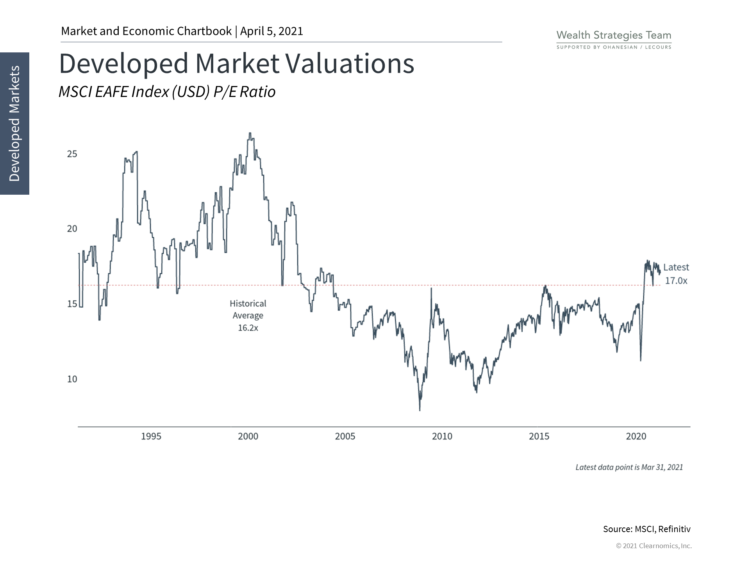
Developed markets valuations remain somewhat lower than their U.S. counterpart.

Slide 4
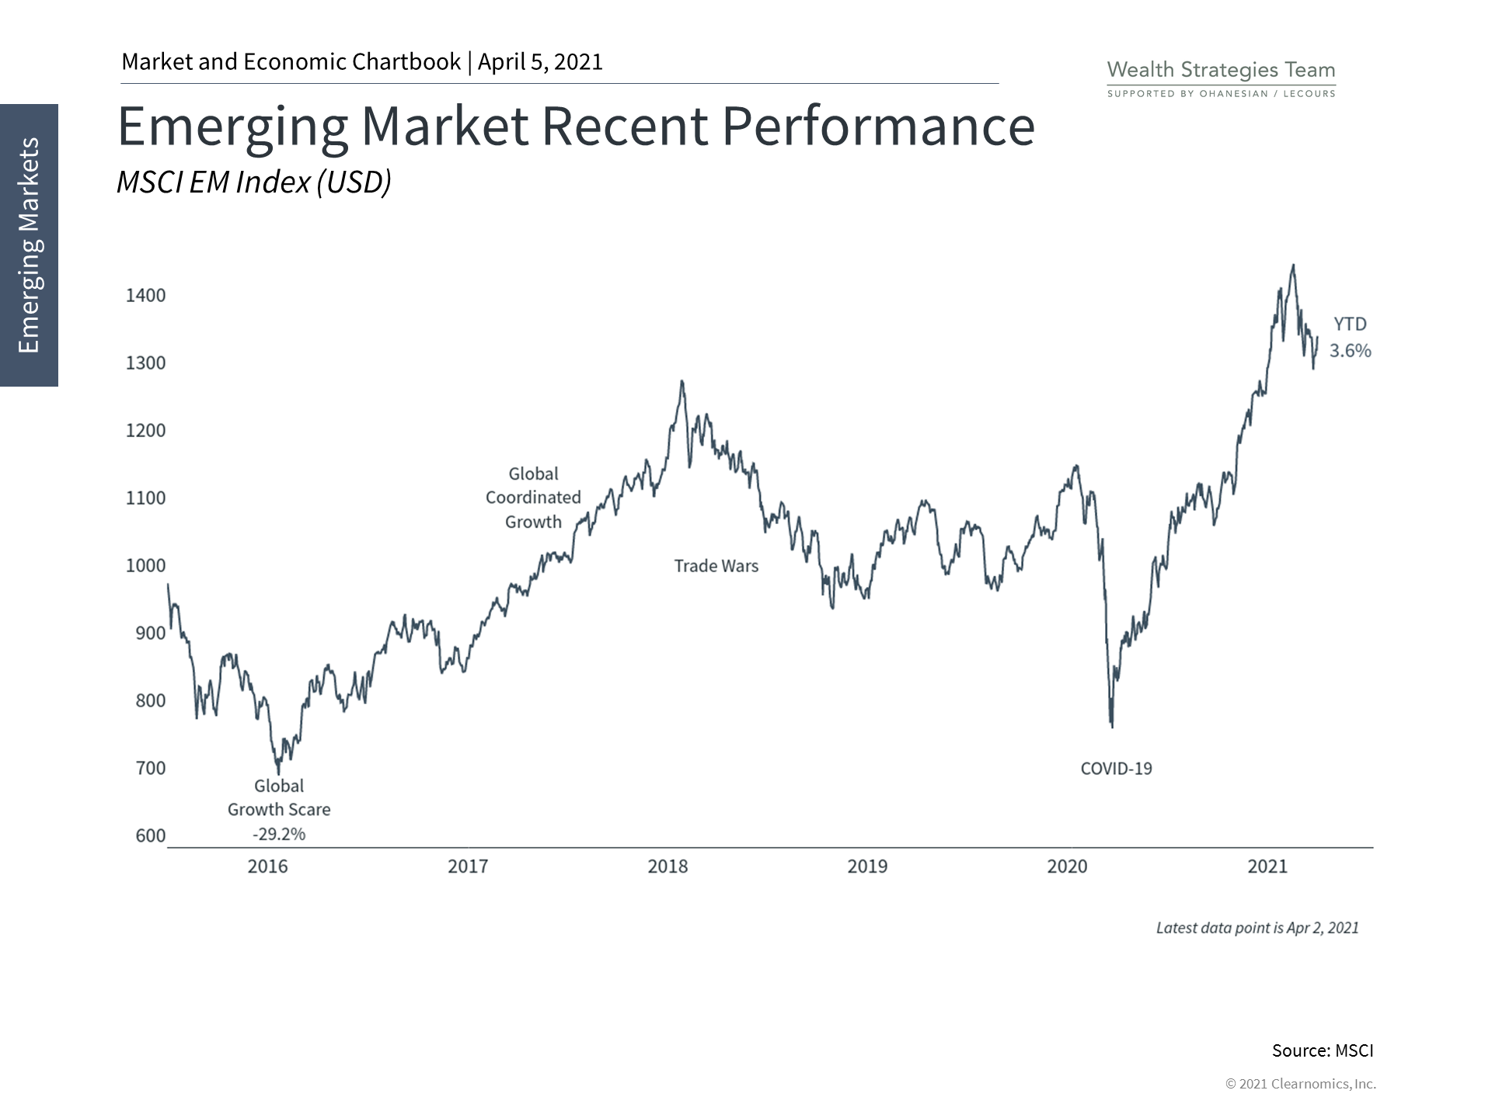
Emerging markets were one of the best performing asset classes in 2020 following the pandemic market crash.
Even before the pandemic, the asset class had been volatile over the past decade due to growth concerns.
Longer term, emerging markets should play an important role in portfolio diversification.

Slide 5
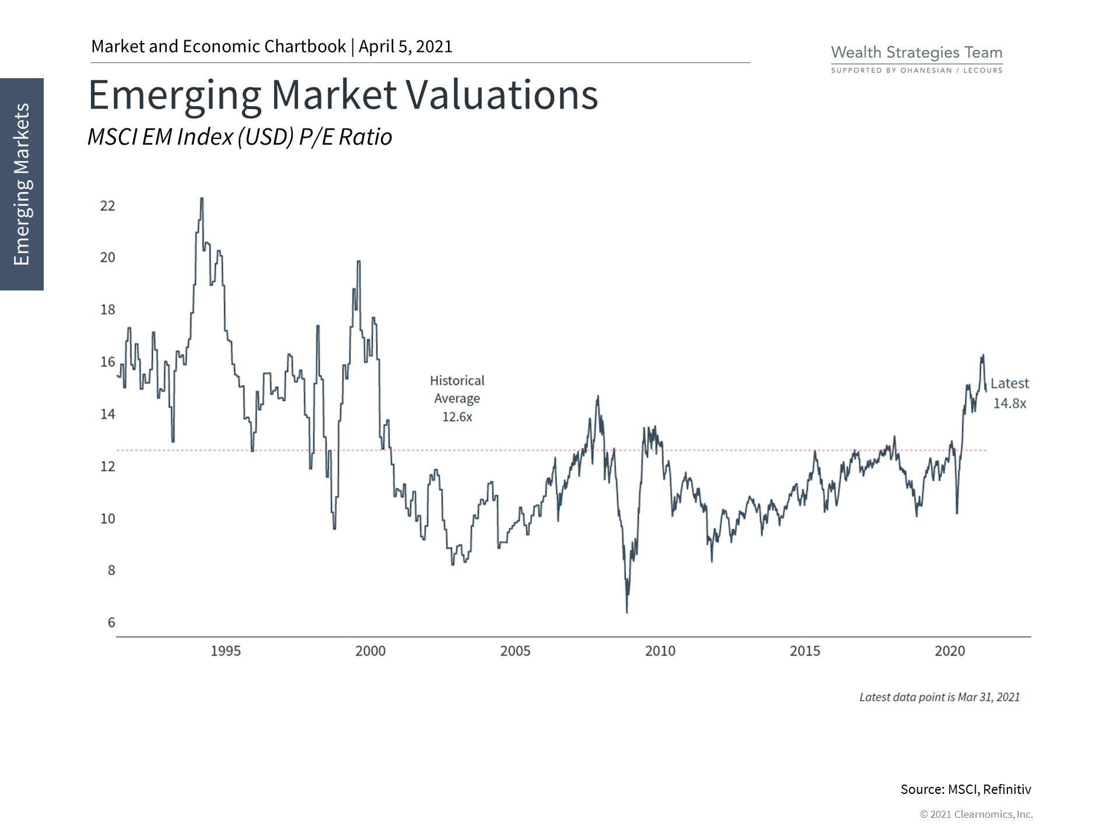
Although they face significant risks, emerging market stocks are still the cheapest of the major regions by many measures.

Slide 6
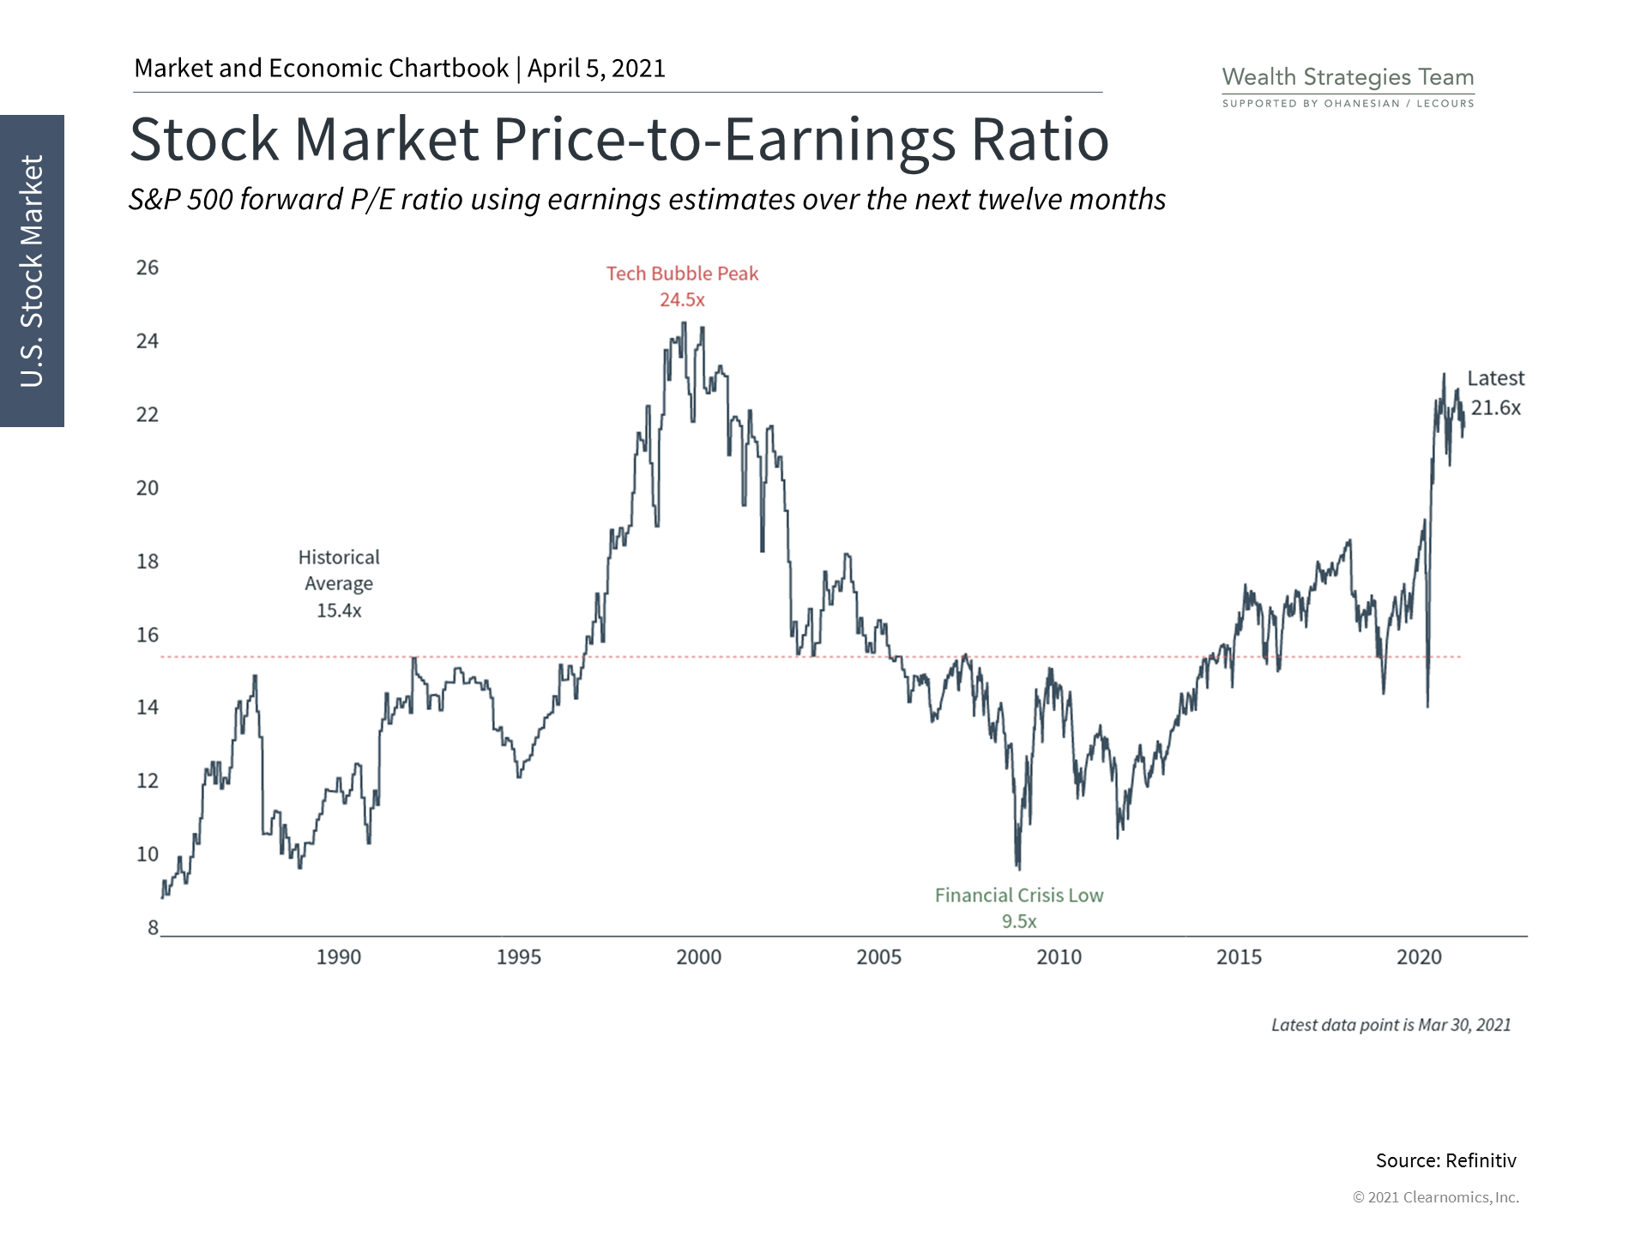
This valuation measure is a forward estimate of earning recovering from the pandemic and the resulting lock down.
It is higher than overseas market's measures, however the U.S. is having a strong recovery.
Investors should exercise caution and properly diversify across asset classes, both in the U.S. and globally.

Slide 7
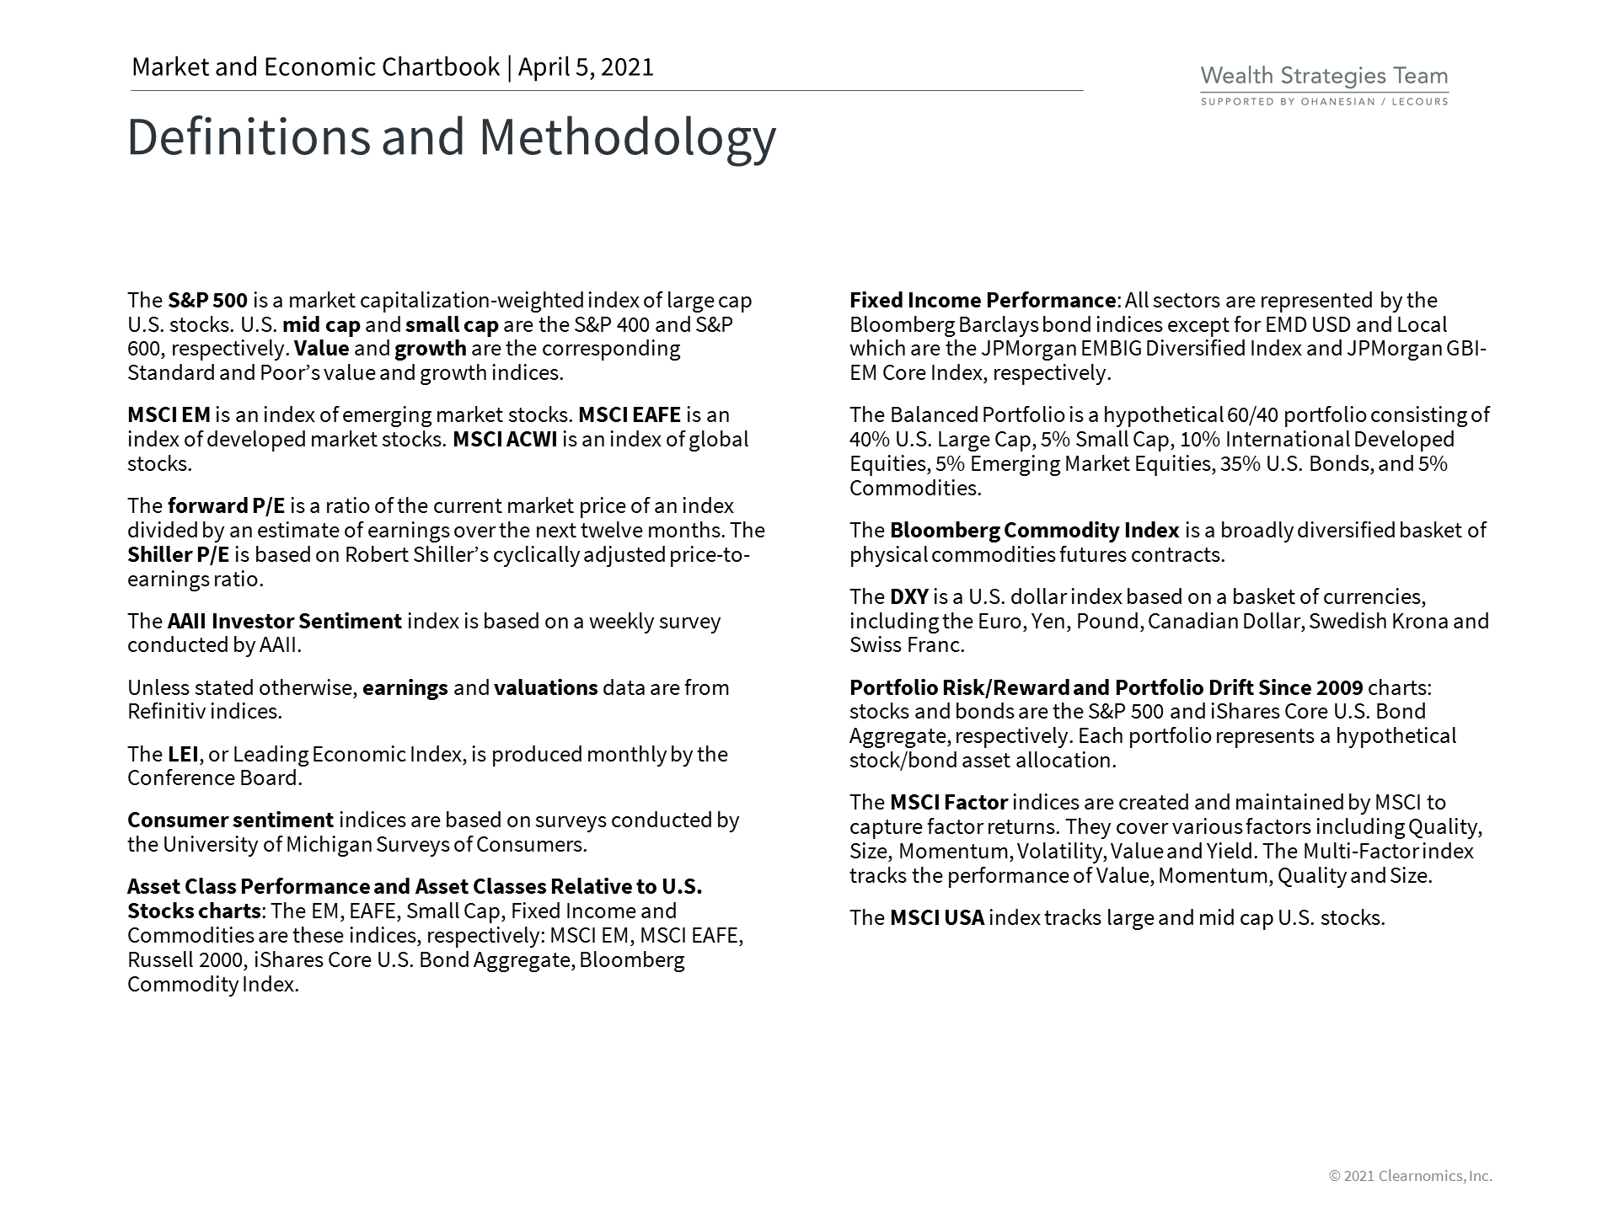

Slide 8
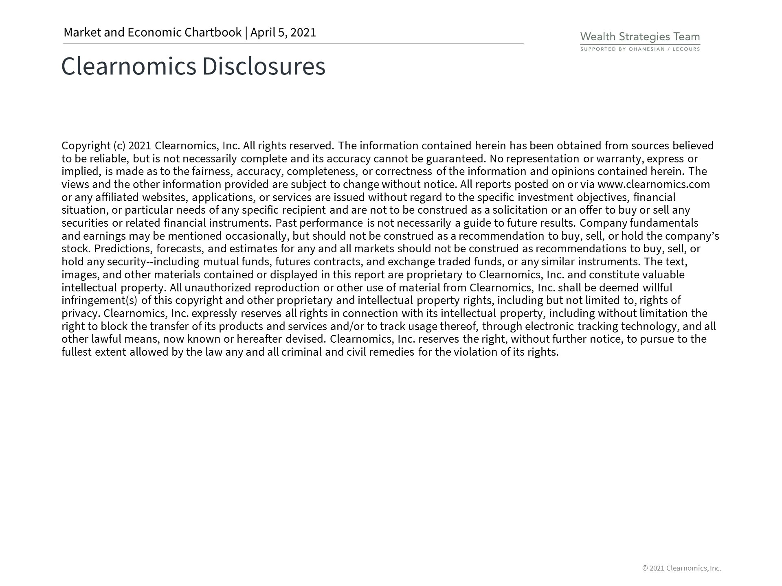
Securities offered through Registered Representatives of Cambridge Investment Research, Inc., a broker dealer member FINRA/SIPC. Advisory services through Cambridge Investment Research Advisors, Inc., a Registered Investment Adviser. Cambridge and Ohanesian / Lecours are not affiliated. Indices mentioned are unmanaged and cannot be invested into directly. Past performance is no guarantee of future results. Diversification and asset allocation strategies do not assure profit or protect against loss. Investing involves risk. Any investment involves potential loss of principal

