Slide 1
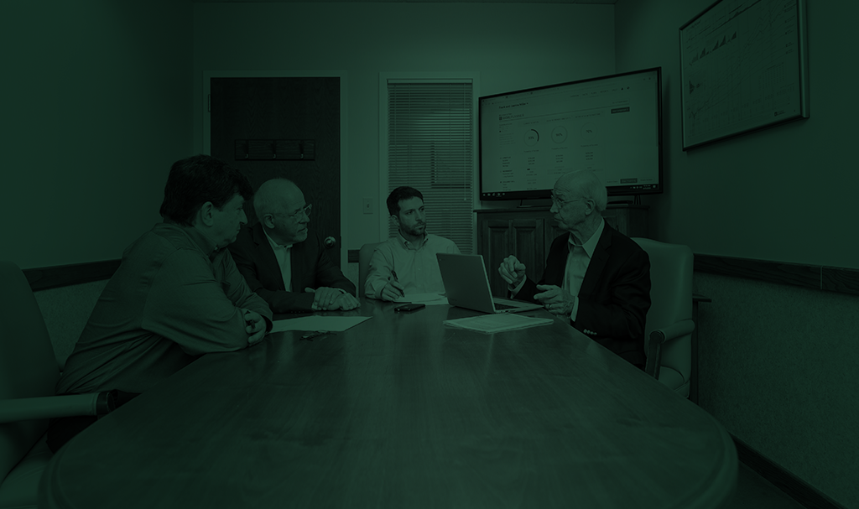
Watching for Inflation?- Chartbook
Cliff Jarvis | Vice President - Investments | May 5, 2021

Slide 2
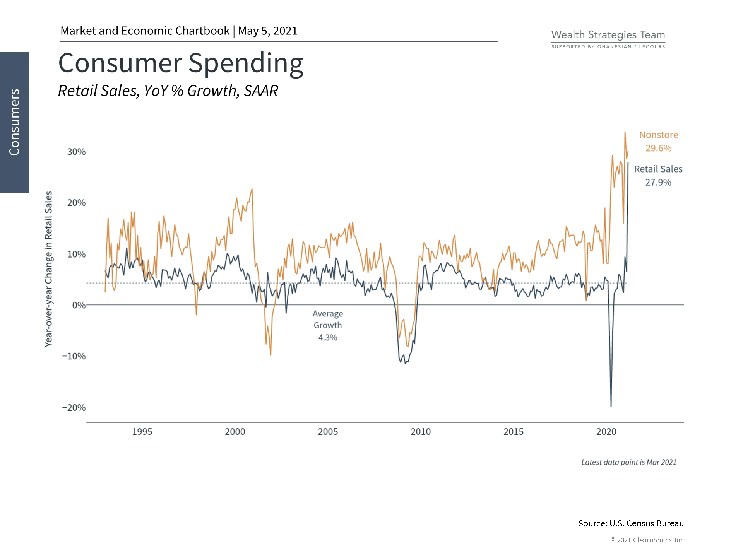
Retail sales are an important way to measure consumer spending.
Our government's efforts to cope with the Covid-19 shut down should fuel a burst of strong consumer spending.

Slide 3
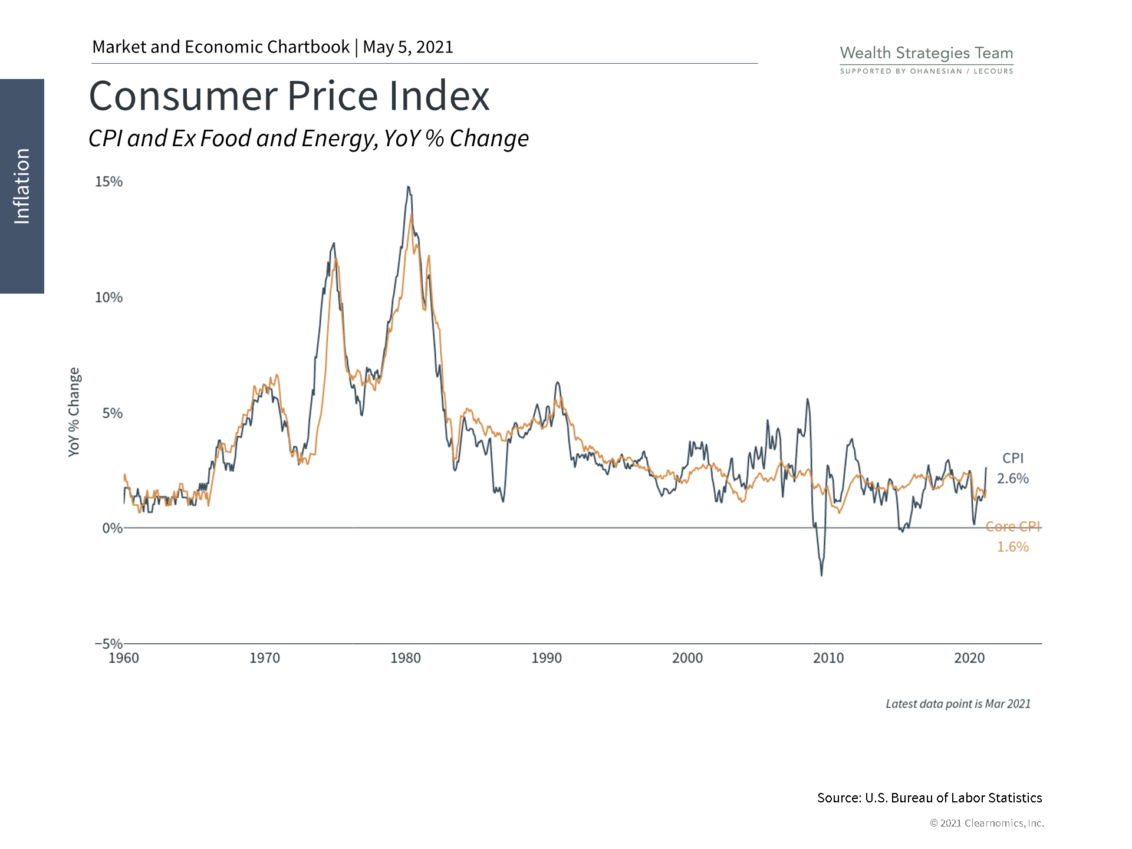
CPI is a commonly cited measure of inflation. It uses a basket of goods and services to track price changes for consumers.
In order to measure the underlying trend in inflation, rather than temporary shocks to food and energy, economists often focus on Core CPI.
Thus far, CPI inflation remains subdued.

Slide 4
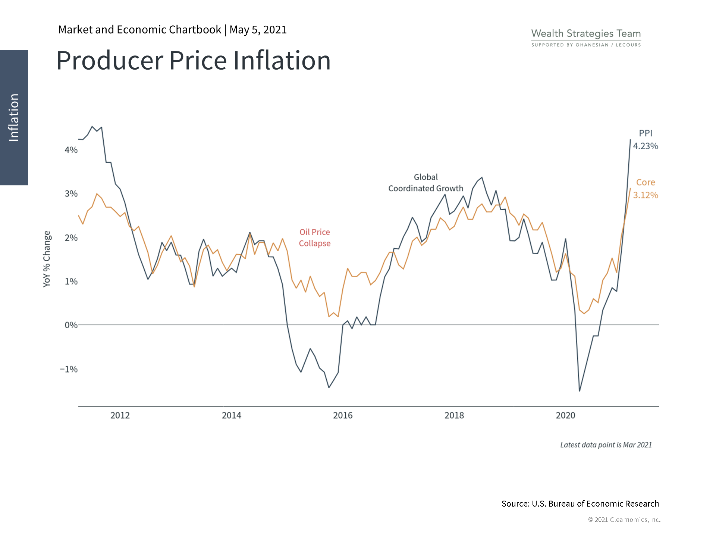
PPI measures price levels for producers. They are another data point for understanding overall inflation trends.
Inflation is now rising during the recovery as monetary and fiscal stimulus boost spending.

Slide 5
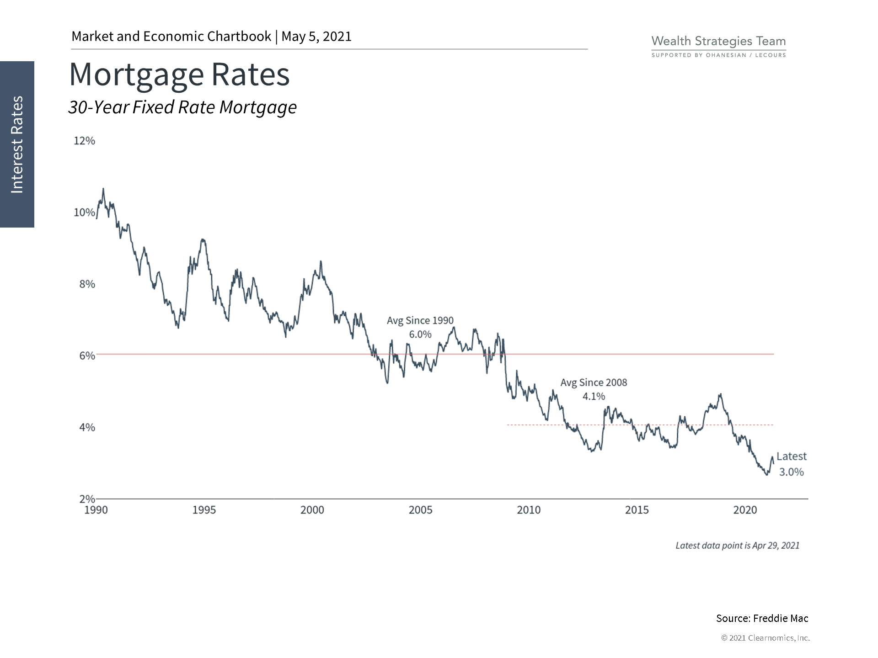
Interest rates have been falling for decades. For example, mortgage rates are currently around 3%; down from a 30 year high of over 10%.

Slide 6
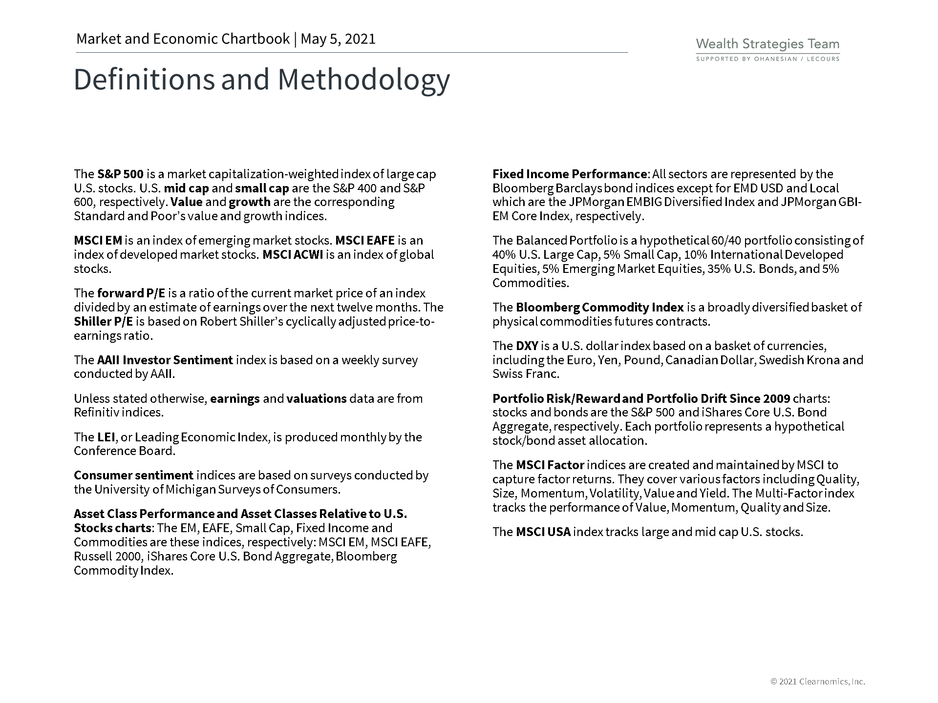

Slide 7
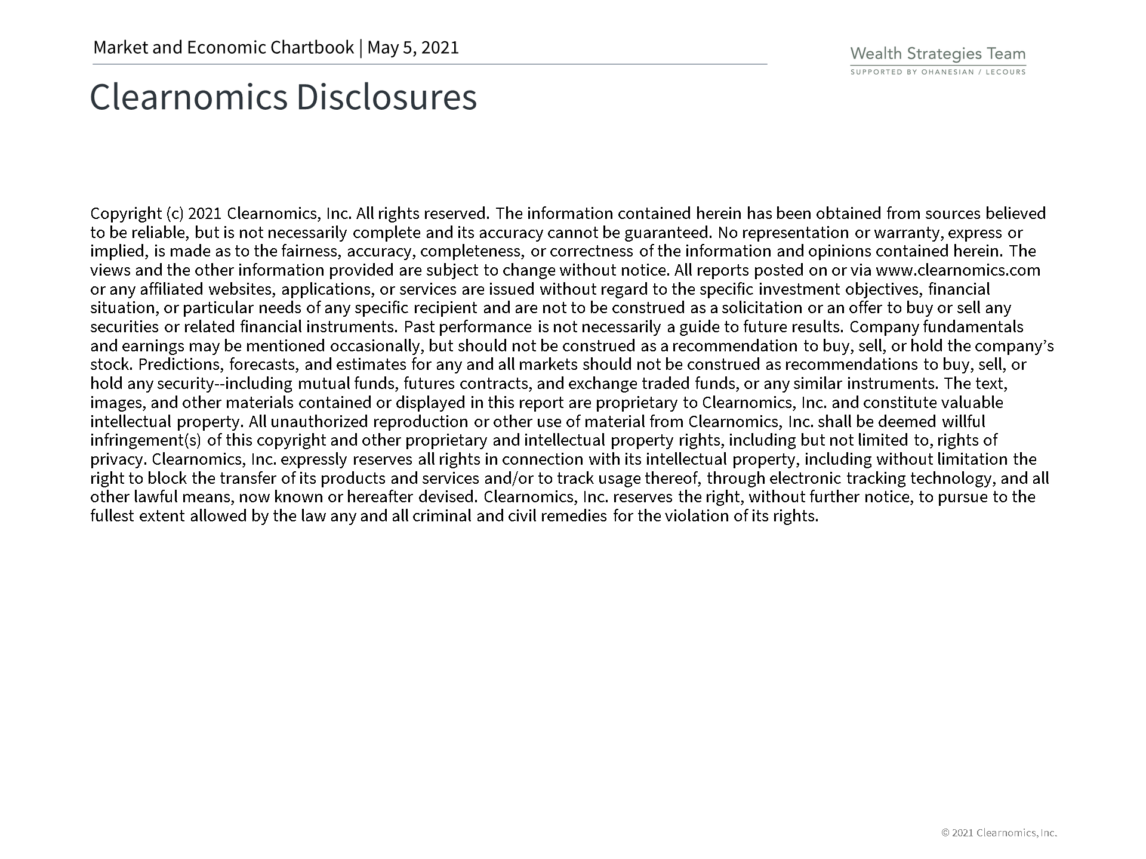
Securities offered through Registered Representatives of Cambridge Investment Research, Inc., a broker dealer member FINRA/SIPC. Advisory services through Cambridge Investment Research Advisors, Inc., a Registered Investment Adviser. Cambridge and Ohanesian / Lecours are not affiliated. Indices mentioned are unmanaged and cannot be invested into directly. Past performance is no guarantee of future results. Diversification and asset allocation strategies do not assure profit or protect against loss. Investing involves risk. Any investment involves potential loss of principal

